Slide 1

AI for Cardiovascular Risk Prediction
Team Name: CODESTORM
Members : Divya Sindhu , Jiya Thakker

Slide 2

Problem Statement
Ravi, 34, collapsed during a morning walk.
Doctors said the warning signs were in his health reports for years but no one noticed them.
This happens to millions.
Subtle changes in BP, cholesterol, or blood sugar often get ignored.
AI can detect these risks early — before symptoms appear.
THIS IS THE REAL PROBLEM:
WE HAVE THE DATA TO SAVE LIVES BUT NO INTELLIGENT TOOL TO READ IT BEFORE IT’S TOO LATE.
AI CAN DO WHAT HUMANS CANNOT:
SPOT HIDDEN RISK PATTERNS EARLY, CONSISTENTLY, AND AT SCALE.

Slide 3
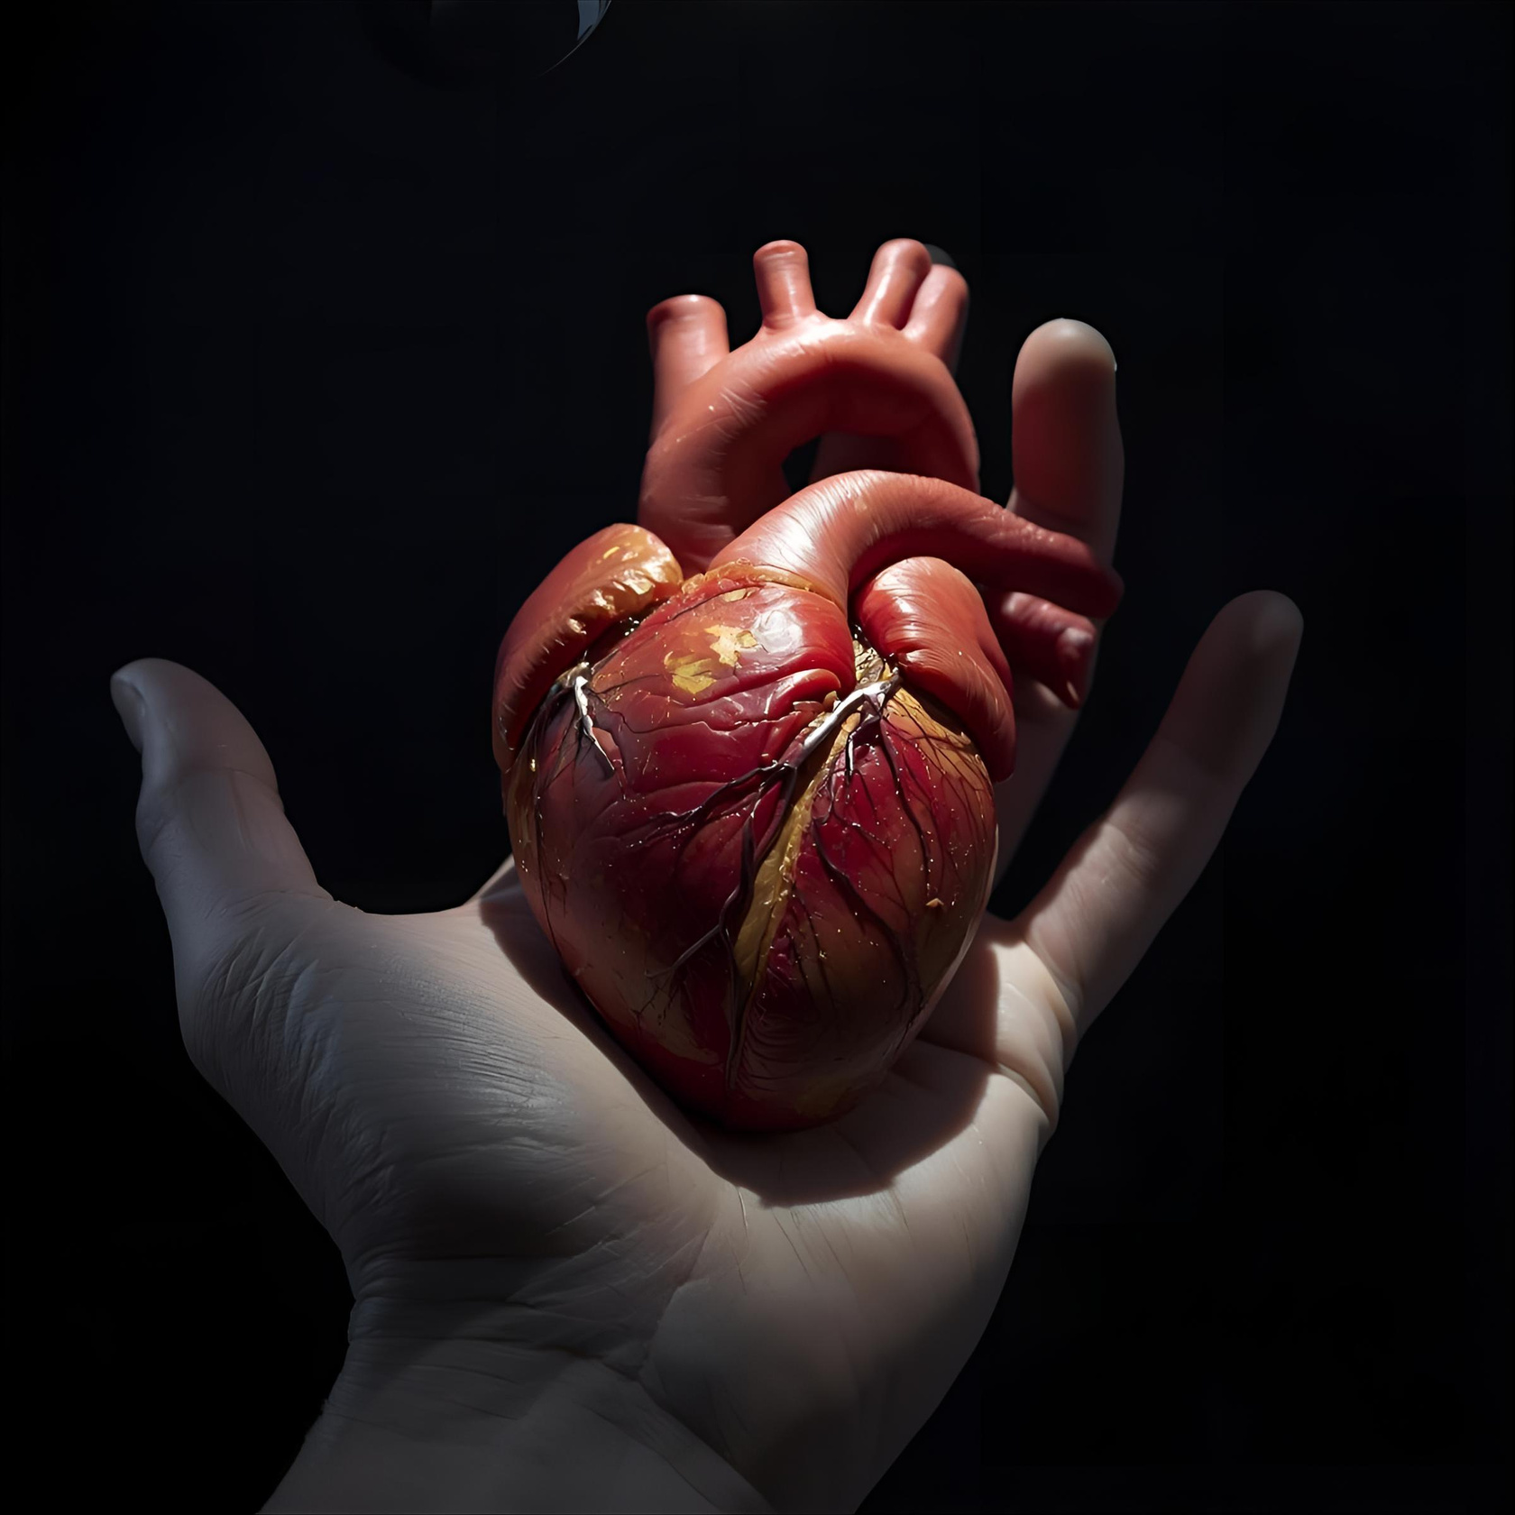
Why This Matters
EIGHTY PERCENT OF CARDIAC EVENTS ARE PREVENTABLE WITH EARLY DETECTION. THIS ISSUE IS SIGNIFICANT BECAUSE TIMELY PREDICTION CAN SAVE LIVES—PROVIDED WE LEVERAGE ARTIFICIAL INTELLIGENCE TO IDENTIFY PATTERNS BEYOND HUMAN CAPABILITY.
3

Slide 4
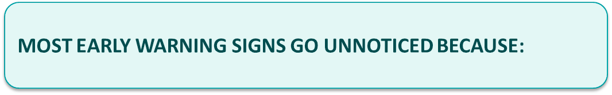
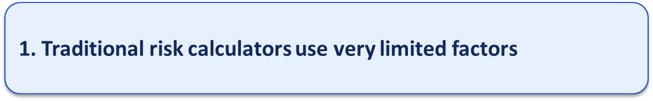
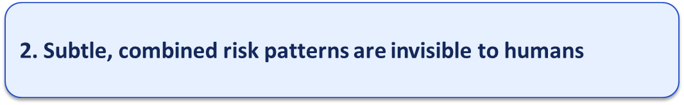
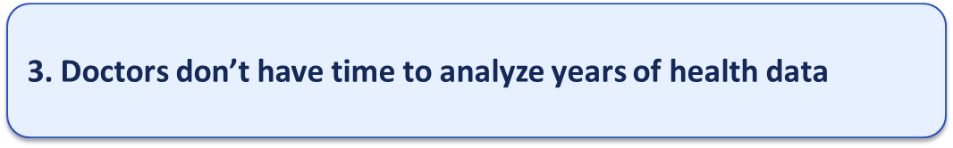

Slide 5
solution overview
ANALYZING ROUTINE HEALTH DATA
•WHEN EVALUATING ROUTINE HEALTH DATA SUCH AS BLOOD PRESSURE, CHOLESTEROL, GLUCOSE LEVELS, BMI, AND LIFESTYLE FACTORS, CONSIDER THE FOLLOWING STEPS:
•Identify hidden risk patterns early**
•Predict whether a patient falls into Low, Medium, or High risk categories
•Provide a clear explanation of the reasons behind the patient's risk level
Despite having years of patient data, we still fail to detect cardiovascular rise early.
Traditional tools miss subtle patterns, and doctors cannot manually analyze multiple health parameters together.
GOAL: ENABLE EARLY INTERVENTION AND PREVENT LIFE-THREATENING HEART EVENTS
.
4

Slide 6
Proposed Solution
Uses simple health inputs (BP, cholesterol, glucose, BMI, lifestyle)
Learns patterns from thousands of patient records
Predicts future risk as Low / Medium / High
WE PROPOSE AN AI-POWERED CARDIOVASCULAR RISK PREDICTION SYSTEM THAT:
Shows clear explanations for each prediction (using SHAP)
Helps doctors and patients take early preventive actions
More
6

Slide 7

Data & Features
DATASETS USED
UCI Heart Disease Dataset
Kaggle Cardiovascular Risk Dataset
THESE FEATURES HELP THE MODEL LEARN PATTERNS THAT INDICATE EARLY CARDIOVASCULAR RISK.
KEY FEATURES CONSIDERED
•Demographics: Age, gender
•Vitals: Systolic BP, Diastolic BP, Heart rate
•Lab values: Cholesterol (LDL/HDL), Glucose levels
•Health metrics: BMI, Obesity indicators
•Lifestyle: Smoking, physical activity, alcohol
•Medical history: Diabetes, hypertension, family history
5

Slide 8
Technical Methodology
1. Data Preprocessing
2. Model Training
Clean and normalize numeric data
Encode categorical variables
Handle missing values
Split dataset into Train / Test sets
Baseline: Logistic Regression
Improved: Random Forest
Best: XGBoost (highest accuracy & AUC)
Evaluation Metrics
4. Explainability
Accuracy
ROC–AUC Score
Precision & Recall
SHAP values used to highlight key risk factors per patient
(e.g., high BP, LDL, smoking, glucose)
10

Slide 9
Tools, Models & Architecture
Tools & Technologies
Models Used
System Architecture
Python (Pandas, NumPy)
Scikit-learn, XGBoost
SHAP (explainability)
Streamlit / Flask (for dashboard/demo)
Logistic Regression (baseline)
Random Forest
XGBoost (best-performing model)
User Input
→ Preprocessing
→ ML Risk Prediction Model
→ Risk Score (Low/Medium/High)
→ SHAP Explanation
→ Dashboard Output
7

Slide 10
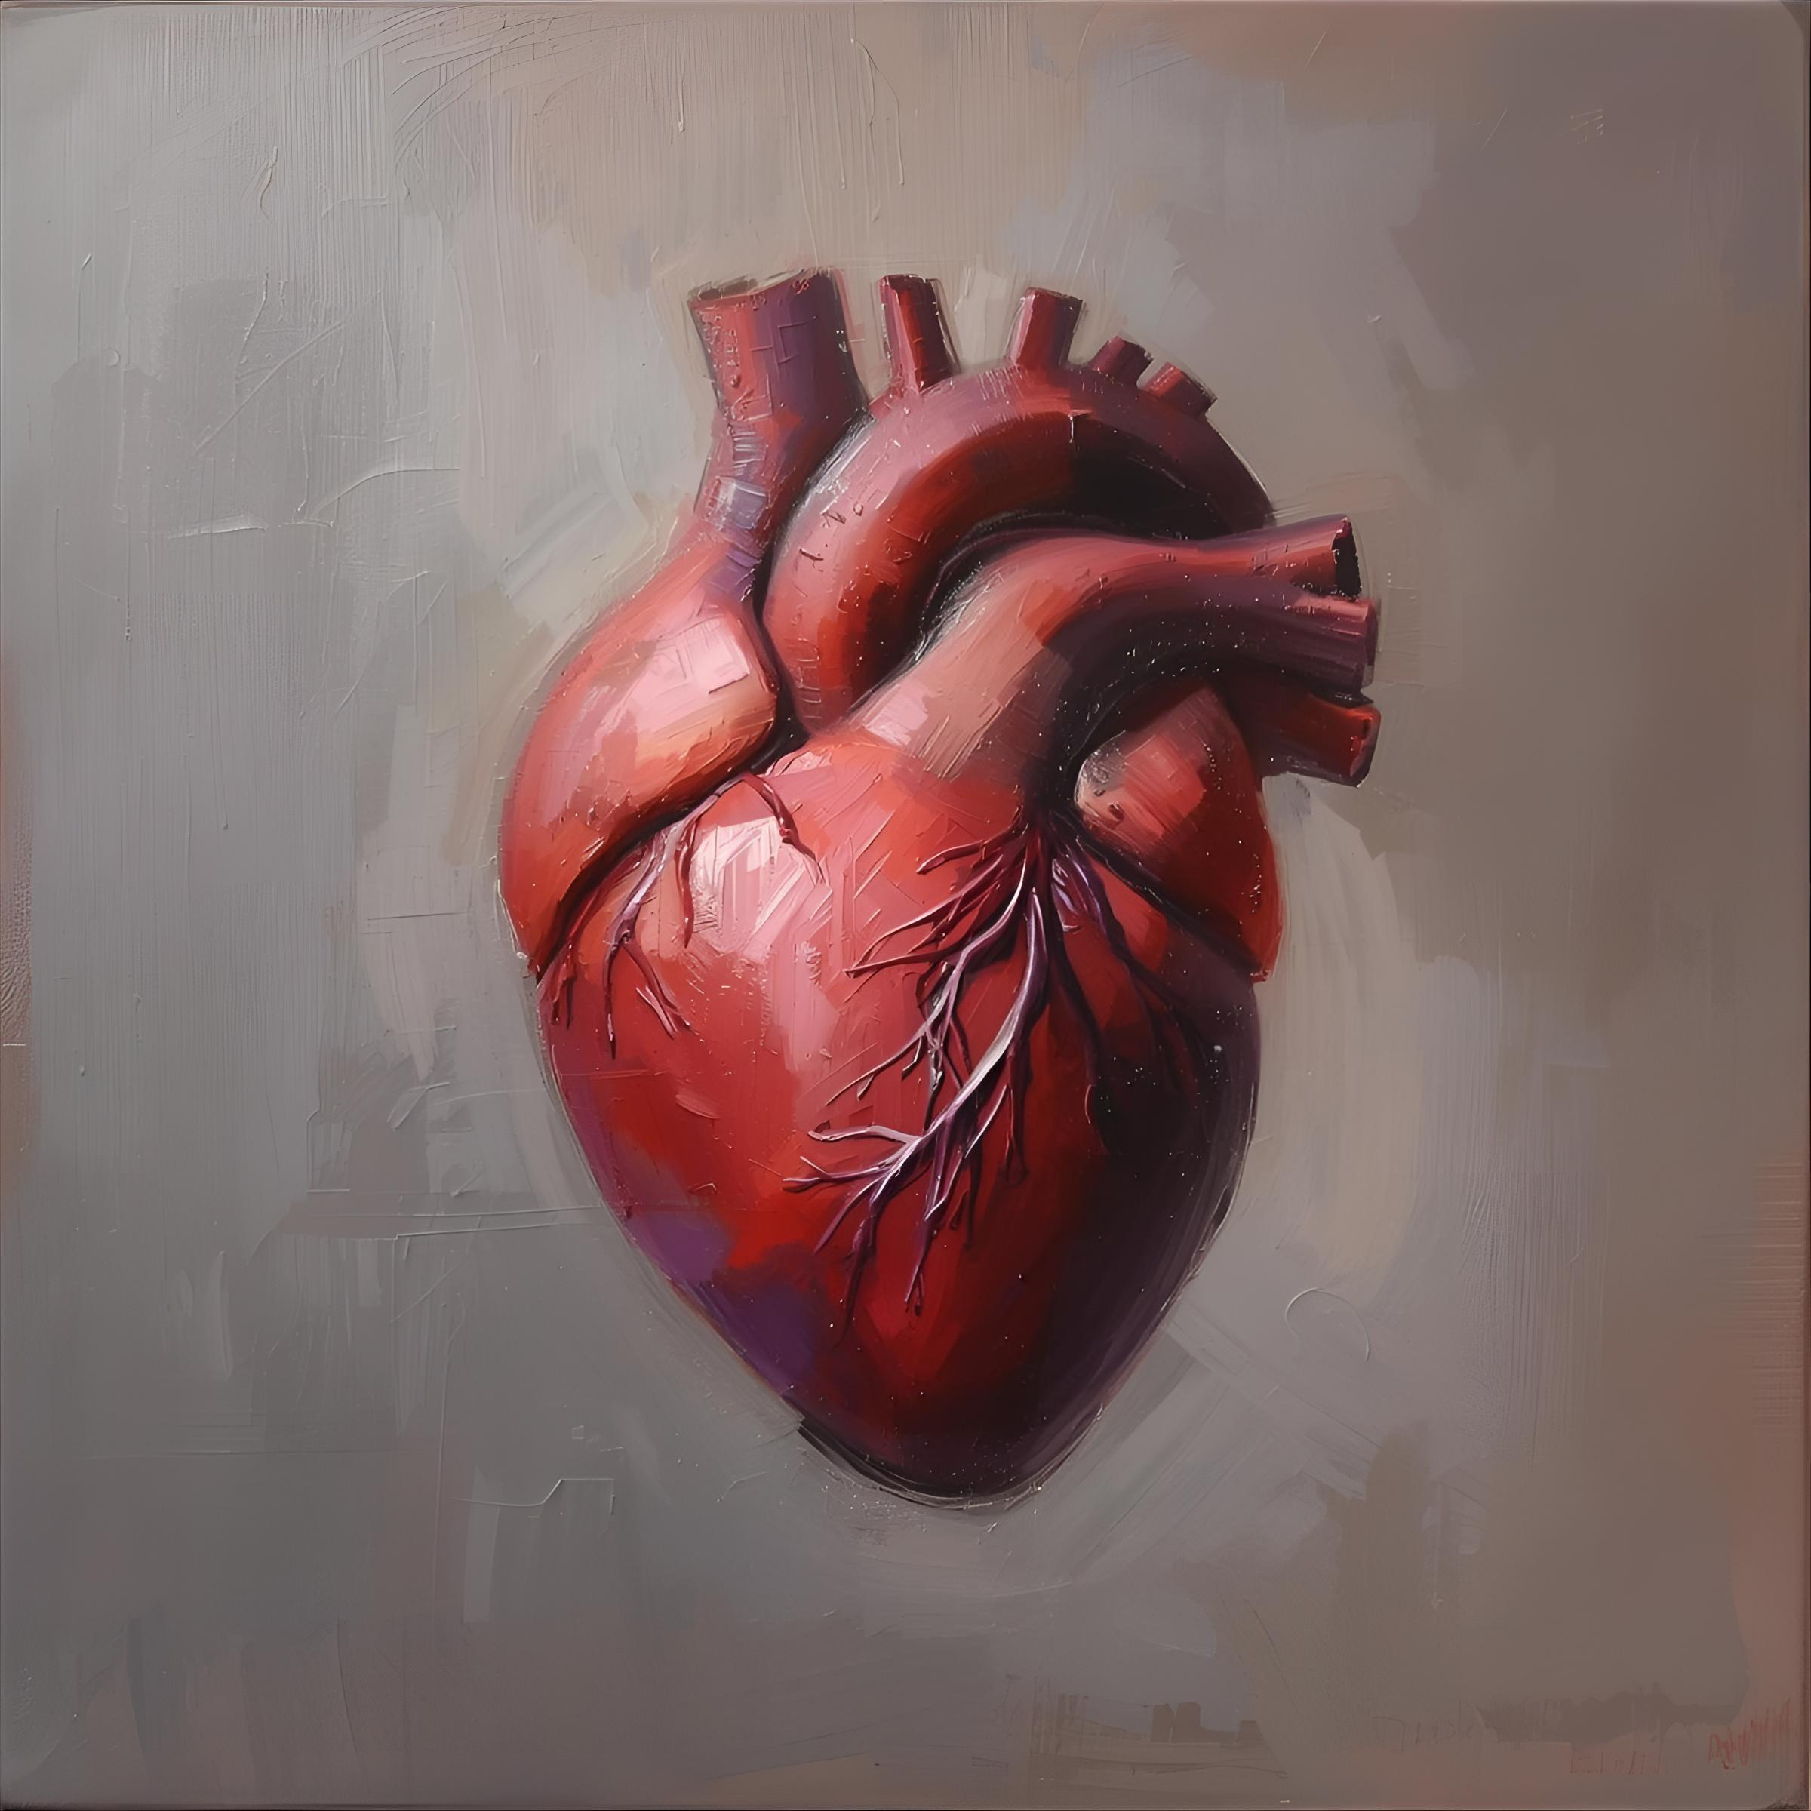
Results
Key Insights from Explainability
Model Performance
High systolic blood pressure was the strongest risk contributor
Elevated LDL and glucose levels significantly increased risk
Lifestyle factors like smoking had major impact
ROC–AUC: 0.92
High accuracy in detecting high-risk patients
XGBoost outperformed all baseline models
7

Slide 11
Expected Impact
For Doctors
Faster, data-backed decision-making
Ability to prioritize high-risk patients
Better monitoring over time
For Patients
Early warning before symptoms appear
Clear understanding of personal risk factors
Opportunity to take preventive action
For Society
Reduced hospital admissions
Lower long-term healthcare costs
Promotes a culture of preventive health

Slide 12
AI can’t replace doctors —
but it can empower them to catch what humans cannot see.
Thank you.

